Slide 1


Slide 2
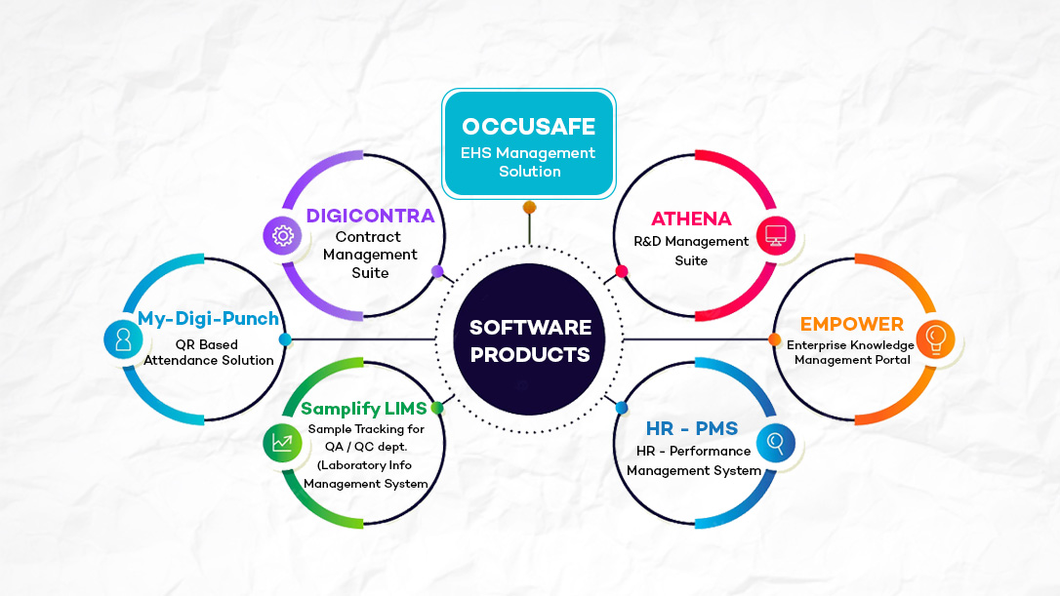
Software Products Offering

Slide 3

t
EHS MANAGEMENT SOLUTION

Slide 4

Demo / Meeting Agenda . . .
Understand existing
EHS Workflow
OccuSafe Presentation
Live software demo
Feedback, Next action plan, Q&A

Slide 5

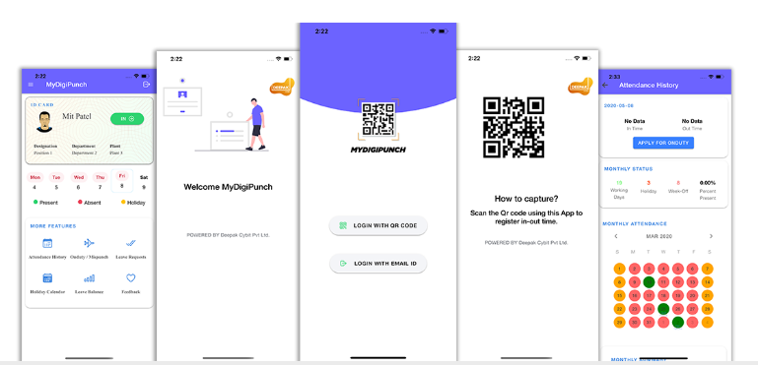
My-Digi-Punch (Digital Attendance System)
No Missed Punches, No Physical Registers
Easy Integration with HR System
QR
Smart Phone based Scanning
QR Based Attendance

Slide 6

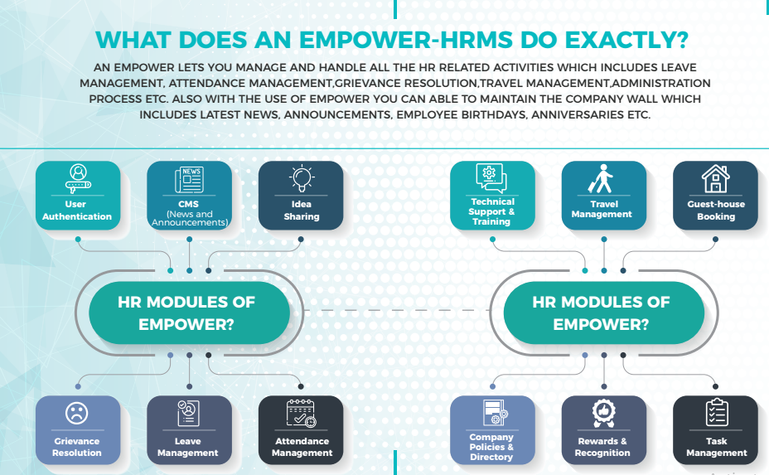

EmPower (Enterprise Knowledge Management Portal)

Slide 7
OccuSafe – Vision and Key Facts
OccuSafe Vision . . .
Key Facts
“To provide one roof integrated EHS Management Solution to ensure workplace safety, manage real time incidences & provide healthy environment to improve industrial productivity using technology based OccuSafe solution...”
Global EHS market - $930M in 2016
& $1.4B by 2020 (Source – MarketWatch)
Every $1 invested, Safety returns $4 to $6 (Source - OSHA)
Waste of average 20 hours a week on administrative tasks (Source: West Monroe)

Slide 8
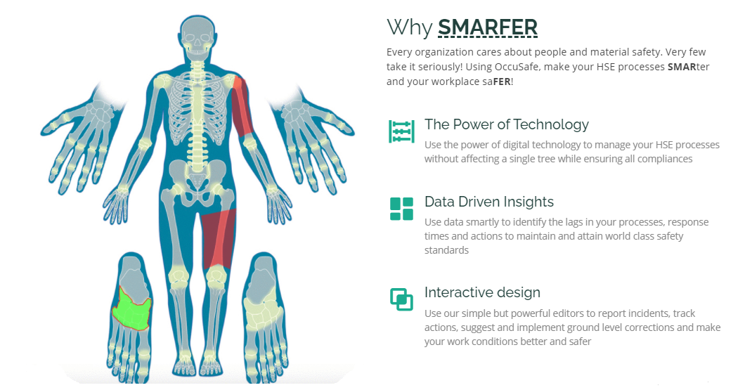
OccuSafe – SMARFER EHS Solution

Slide 9
OccuSafe – Key Modules
a. Incident Management
b. Unsafe Act
c. Unsafe Conditions
PSSR Workflow (Pre-Startup Safety Review)
HIRA & Envn. Aspect Impact Workflow (Hazard Identifications and Risk Assessment)
HAZOP
6
Key Modules
Audit (Document Management)
EHS Training & Assessment

Slide 10
OccuSafe is for you… Key Advantages…
Cost effective, reliable, quick support & User Satisfaction
Action based Pop-up and mailer notifications
Custom Module development, Workload Prioritization
Build Digital Risk Register, Management Dashboard,
Integrated & Intelligent EHS Platform, streamline EHS workflow
Statistics & Analytics Build-up, data study and Predictions
Increase Transparency, Less Legal Compliance issues
Centralized Reporting from multiple Plant locations
Secure Data Environment, Transparent exposure
Save Valuable Administrative Work Time
Follow ISO norms, get Auditable custom built reports

Slide 11
Incident Management – Role & Responsibilities
Top Management
Safety Department
Other Employee
View & monitor Dynamic Digital EHS Dashboard
Easy coordination with EHS team members
Can notify plant hazardous area linked with the Map
View EHS Data Analytics
Get action based Pop-up, mailer notifications
Easy reporting of Unsafe conditions or Acts for actions
Get custom reports for review
Prioritization of specific task based on EHS data
Precautionary notifications from EHS team
Comparative Analysis of Historical data
Get custom reports for periodical Safety Audit
Can see safety dashboard with critical parameters
Predictive EHS budget allocations
Saving valuable Administrative work

Slide 12








Competitive EHS software presence at Chemical Manufacturer . . .

Slide 13







Incident Management - Workflow
Incident Happened
Health Centre Doctor
Health & Safety HEAD
Incident Closed
Team Formation

Slide 14
Incident Management - Workflow
All Authorised Users
Incident Reporting
HC Doctor need to take necessary Action, in case of any Injury
Health Centre Process
Safety Head => Verify Incident Checklist, he will take Investigation decision making
Incident Checklist, Initial Report (IR) generated
Incident Closed
No detailed Investigation Required
Safety head will form Investigation Team i.e. Lead Investigator & other team members
Formation of Team
Lead Investigator will select suitable “RCA method”. Team members will add causes.
RCA Method Selection, Analysis & Recommendation
Lead Investigator (LI) or Team member will add CAPA and will send to Safety Head
CAPA Addition & Assign actions to team by Safety Head
Safety Head will assign CAPA to responsible team member with Timeline
CAPA Assigned person will work on CAPA
CAPA Assigned person will take action on CAPA and will mark as Complete
FIR report generated & submitted to responsible department
Safety Head will Mark CAPA as Complete
Incident Closed

Slide 15






HIRA - Workflow
HIRA HSE HEAD
Residual Risk Calculations
Risk Identified

Slide 16
HIRA - Workflow
Dept Head
Activity created with addition of Hazard
HIRA activity created is submitted to HIRA HSE Plant Manager for Review
Submit as Risk Identified
“HIRA HSE Head” → Put under Risk Assessment. Notification will pop-up
Add Actions and assign responsibility
Team member will take actions and Mark it as Complete with comments/attachments
Auto Residual Risk Calculations
HIRA HSE Plant Manager will calculate Residual Risk with suitable control measures
Residual Risk Assessment
HIRA HSE Head shall review the status and he can again put into Risk Assessment
HIRA workflow repeats as above

Slide 17
PSSR - Workflow
New PSSR creation for specific Node/Section
HSE Plant Manager
Responsibility assigned to Team Members with prior selection of Checklist Type
Checklist Verification
Team member will update Checklist and can assign responsibility to other members as well
Take actions on assigned responsibility
Team member will take actions and Mark it as Complete with comments/attachments
Add Observations & assign responsibility
Observations are added HIRA HSE Plant Mgr. Team member will mark as complete
Observations - Mark as Complete
HSE Plant Manager will mark as FINAL CLOSURE
PSSR – Mark as Final Closure

Slide 18
Software deliverables & Integration with existing Environment
Technology Used – Ruby on Rails
Excel / CSV format
The data can be Exported from OccuSafe & imported to other Software's via Excel/CSV import
API Integration
Data will be provided via API – JSON format
Reports via E-mail
Daily, Weekly, Monthly & yearly reports can be sent via E-mail
Database Access
Data in Read-Only format can access via SQL query

Slide 19
OccuSafe is for you… Key Advantages…
Stay active, alert (24X7) and responsive at all times
Complete your tasks in timely manner
Acknowledge & respond to all Messages, task posted in Group
Strictly follow the SM communication channel
Expected to stay connected with your branch’s social media heads
Attend the meeting periodically on Monthly / Bi-weekly basis
Report of your progress on tasks assigned.
You should be pro-active and consult your branch heads
You should be responsible for what you post.
You should be pro-active and consult your branch head
Do not post any unethical / contradictory/ conflicting message

Slide 20
Covid Challenges and Overall Impact on Sales (April / May)
Drop in Demo Frequency
Facing challenges to confirm demo schedule for OccuSafe due to panic situation in plants
Limited Manpower availability & priority of EHS dept shifted to OHS & monitor Covid cases
Work From Home
WFH scenario in few organizations disturbed their Routine work & it affected demo confirmation for ATHENA suite
Unavailability of whole Team
I found the challenge of availability of team members & shifting of their responsibilities
Someone from team is either hospitalized or under post covid recovery at home
Priority
When it comes to priority, software evaluation is usually preferred on least priority when situation is unusual. Most of the prospects replied that we can plan demo after Covid

Slide 21
How I overcome the existing Challenges (April / May)
Shifted focus on Athena/LIMS
Due to panic situation in plants, whole EHS dept shifted focus to OHS & monitor Covid cases
I shifted my focused on Athena & LIMS product to initiate demo sessions and got 3 – 4 demo by end of the month
Utilizing WFH time
I proposed end user to utilize this lock down phase for online demo activities as a part of software evaluation process
Focus on Marketing Material
I preferred to utilize this period on competitive market analysis, marketing material creation etc
Database upgradation
I preferred to utilize this timeframe for upgrading the database for easy access.

Slide 22
THANK YOU !!

